Slide 1
HemTools Tutorial
4-18-2019
Yichao Li
Yichao.Li@stjude.org
https://hemtools.readthedocs.io

Slide 2
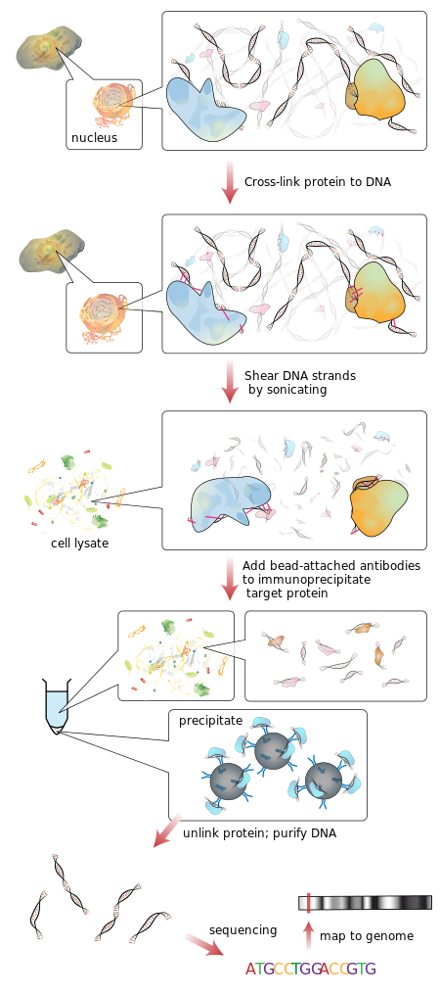
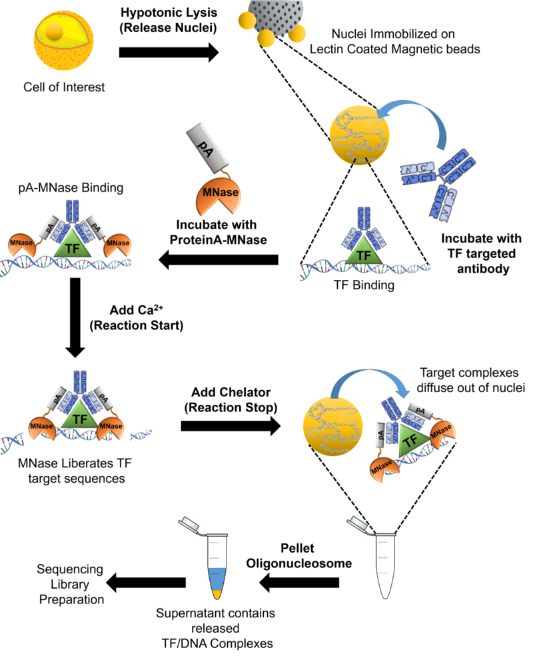
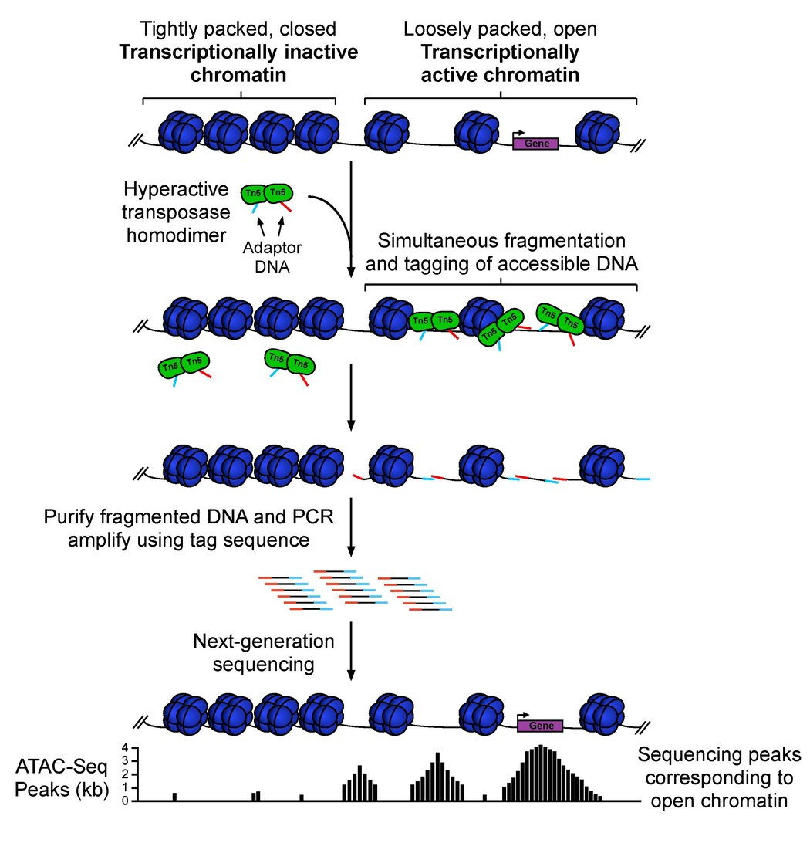
Outline
CUT & RUN
ChIP-seq
Software overview
Examples
ATAC-seq
ChIP-seq
CUT & RUN
General principles
Questionnaire
ATAC-seq

Slide 3
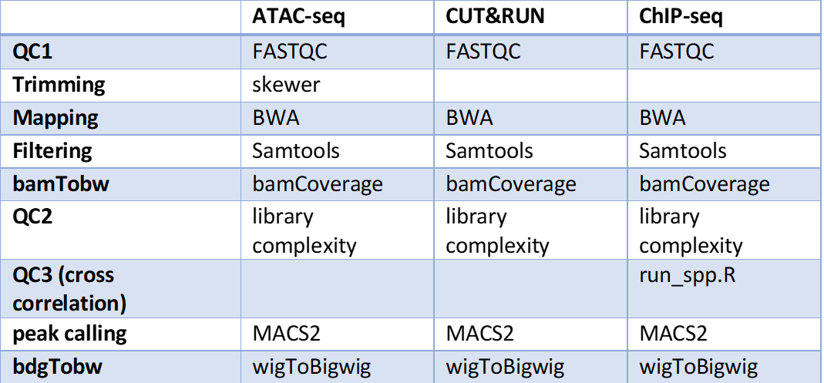
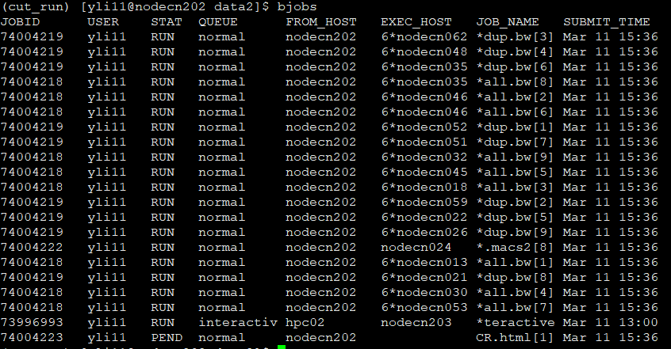
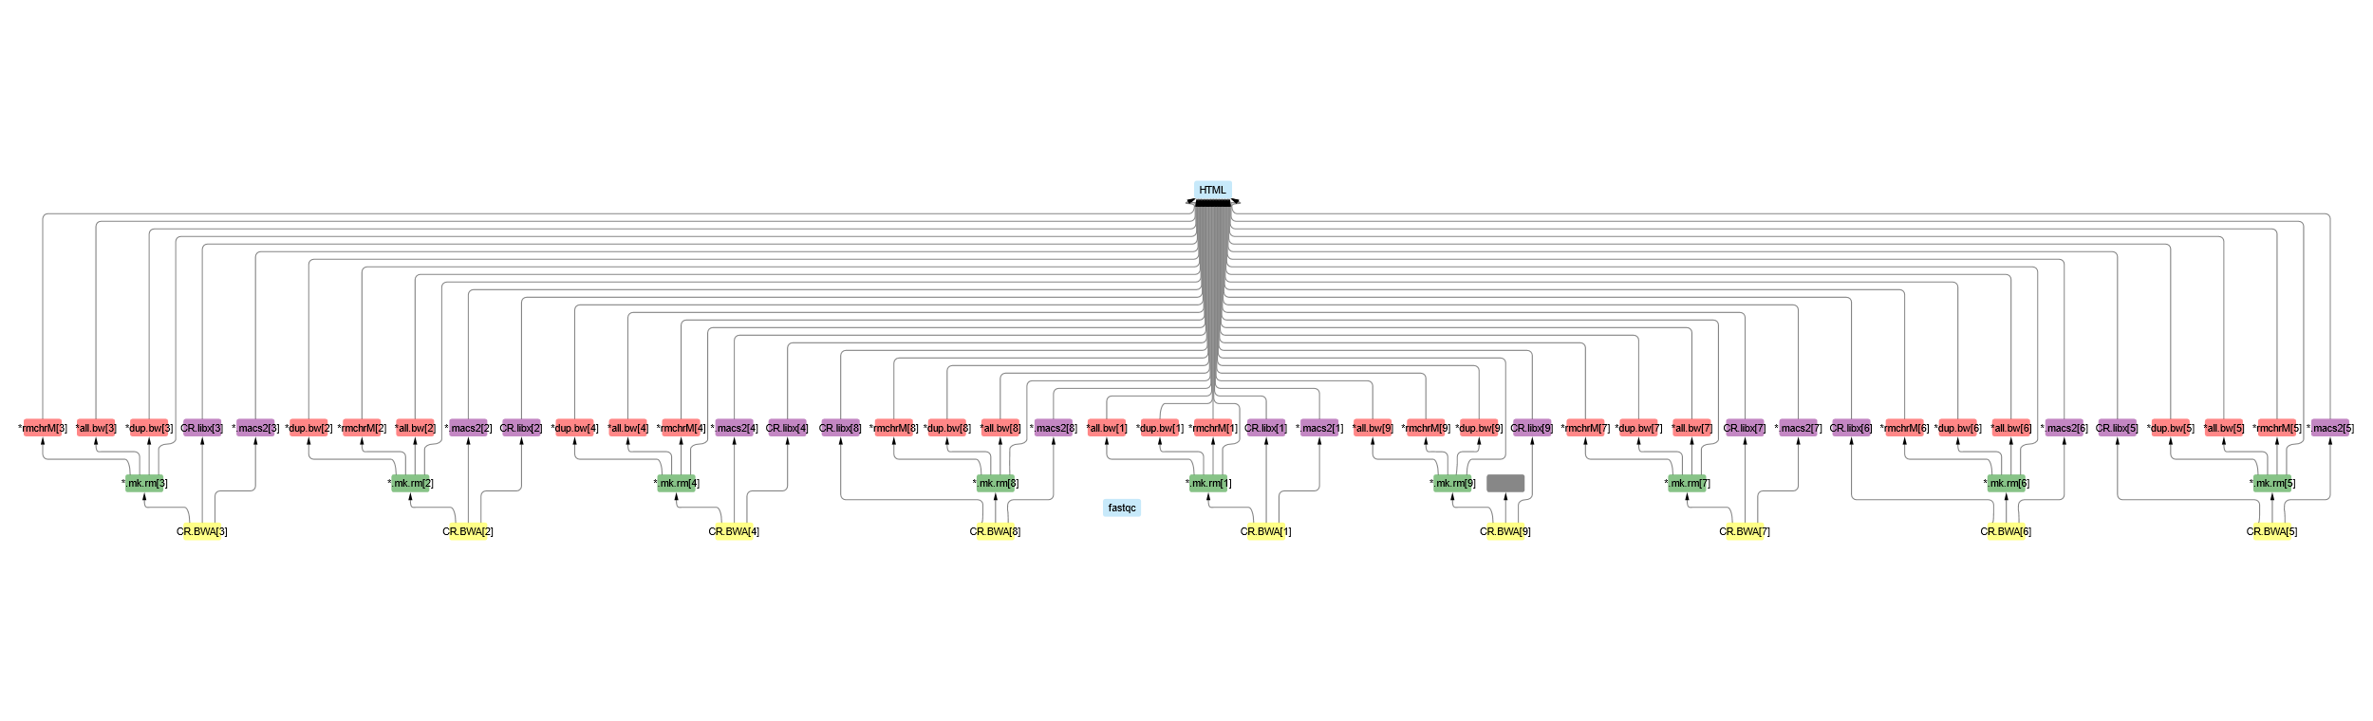
Software overview
Minimizing computation time
A tree of jobs

Slide 4
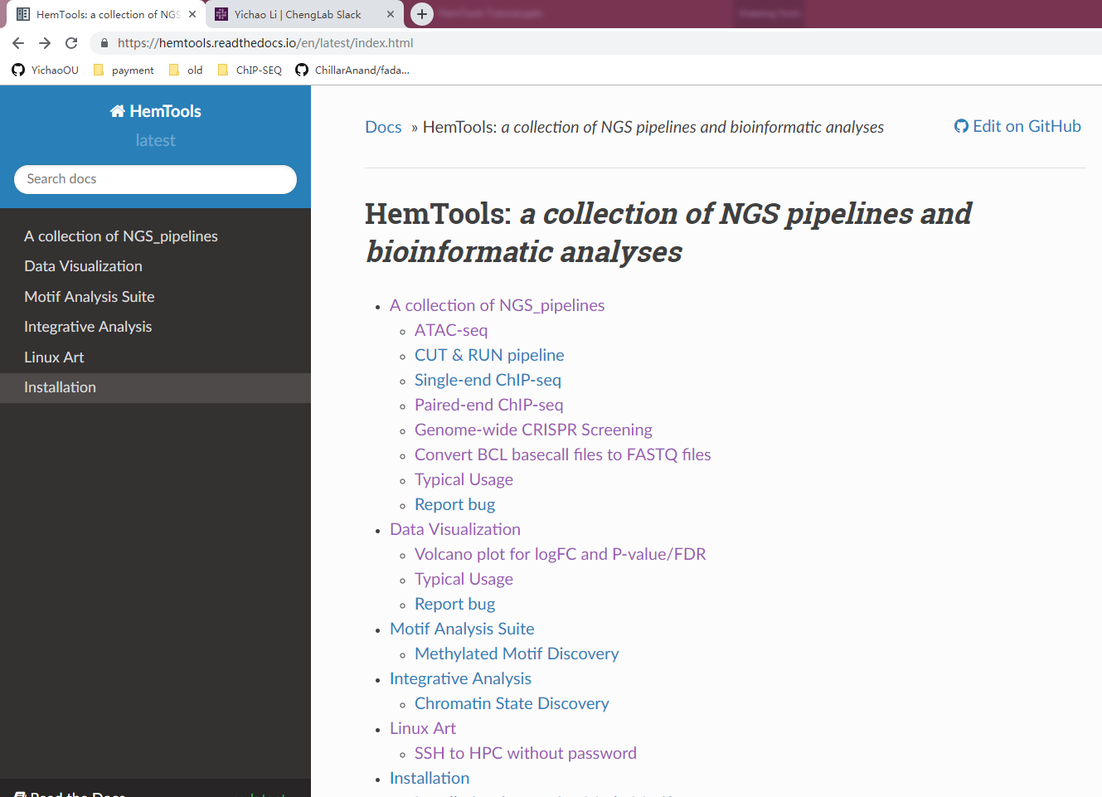
Software overview
Minimizing computation time
A tree of sub-jobs
Creating user-friendly interface
Online documentation
https://hemtools.readthedocs.io

Slide 5
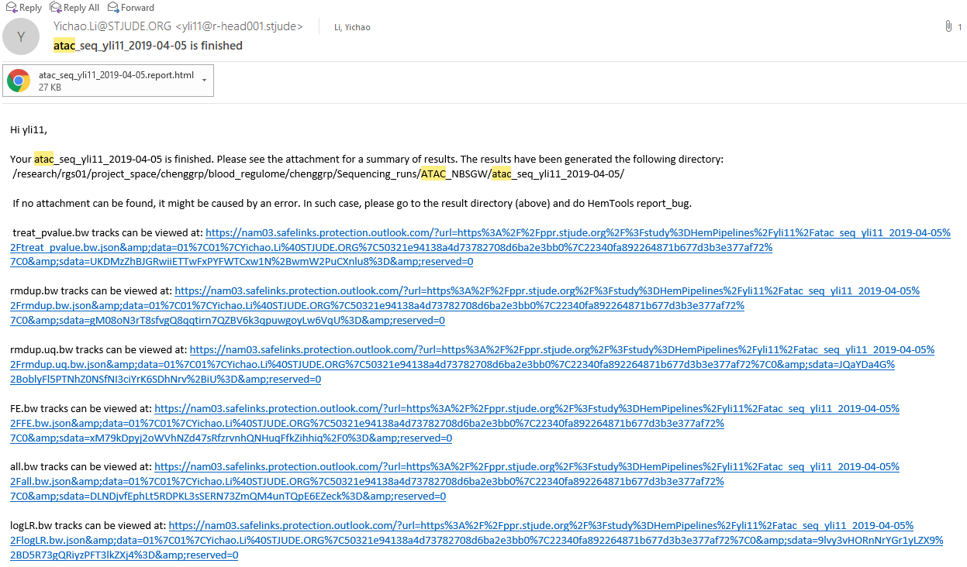
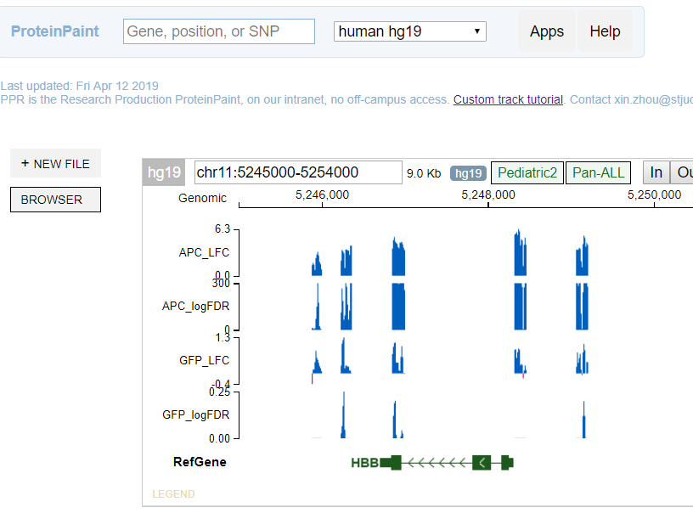
Software overview
Minimizing computation time
A tree of sub-jobs
Creating user-friendly interface
Online documentation
https://hemtools.readthedocs.io
Email notification system

Slide 6
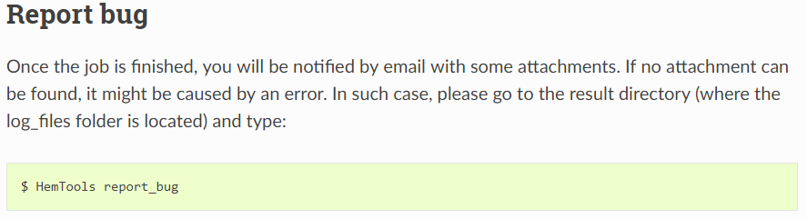
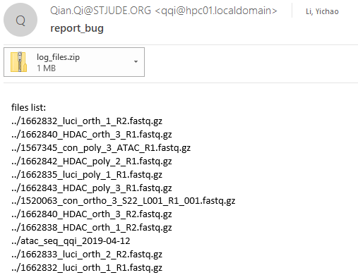
Software overview
Minimizing computation time
A tree of sub-jobs
Creating user-friendly interface
Online documentation
https://hemtools.readthedocs.io
Email notification system
Bug/Error notification system

Slide 7
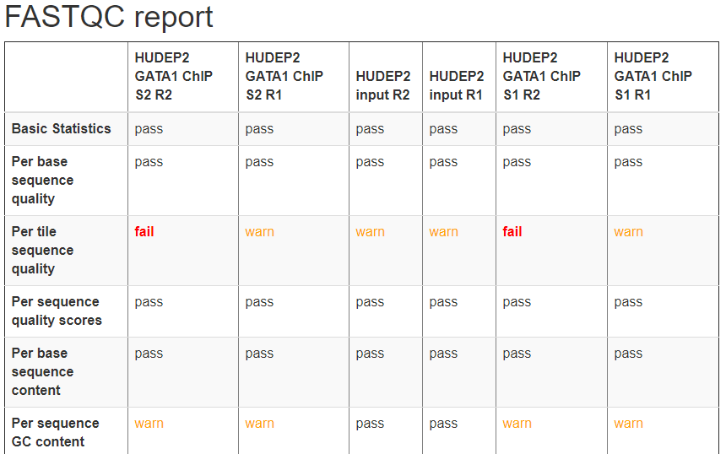
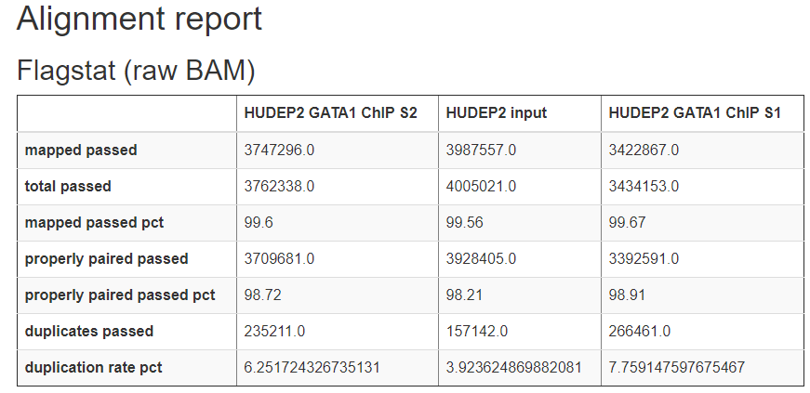
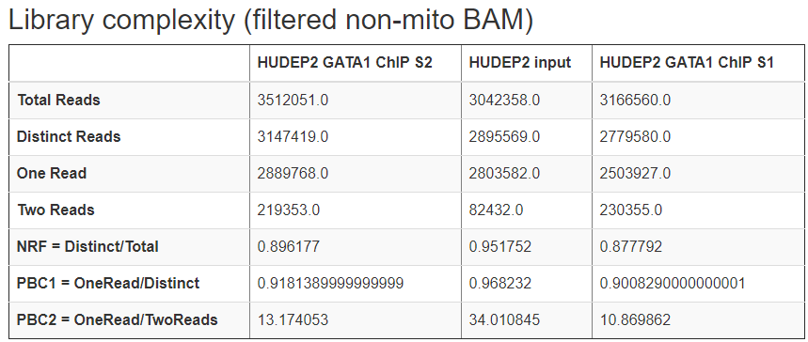
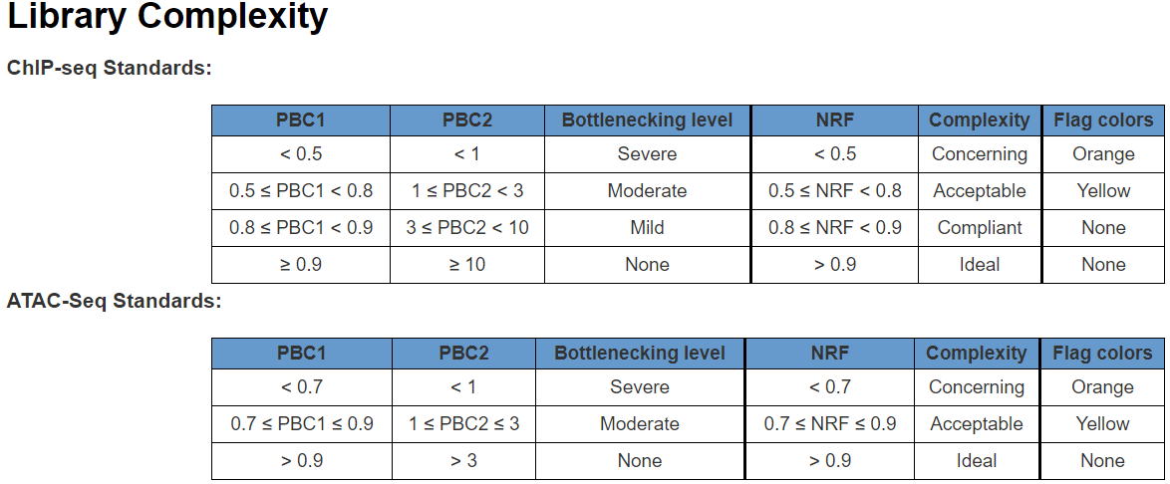
Software overview
Minimizing computation time
A tree of sub-jobs
Creating user-friendly interface
Online documentation
https://hemtools.readthedocs.io
Email notification system
Bug/Error notification system
Visually-appealing reports
https://www.encodeproject.org/data-standards/terms/#library

Slide 8
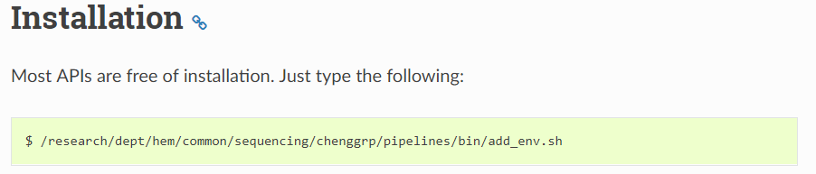
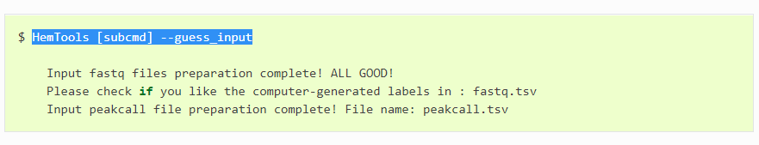
Software overview
Minimizing computation time
A tree of sub-jobs
Creating user-friendly interface
Online documentation
https://hemtools.readthedocs.io
Email notification system
Bug/Error notification system
Visually-appealing reports
Reducing user’s mental effort
Free of installation
Simple input files preparation

Slide 9
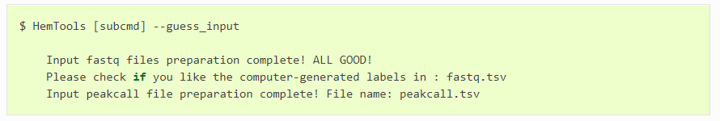
General principles
Workflow
Load Python
Prepare Inputs
Run HemTools

Slide 10
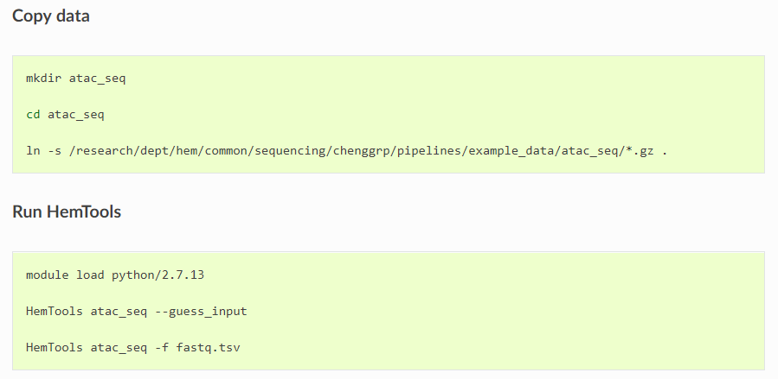
ATAC-seq example
https://hemtools.readthedocs.io/en/latest/content/NGS_pipelines/tutorial.html

Slide 11
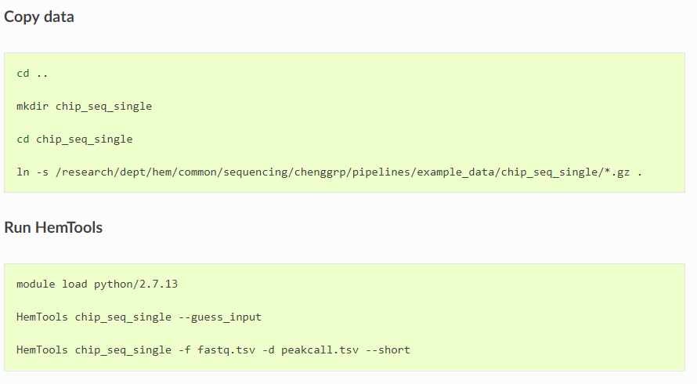
Single-end ChIP-seq example
https://hemtools.readthedocs.io/en/latest/content/NGS_pipelines/tutorial.html

Slide 12
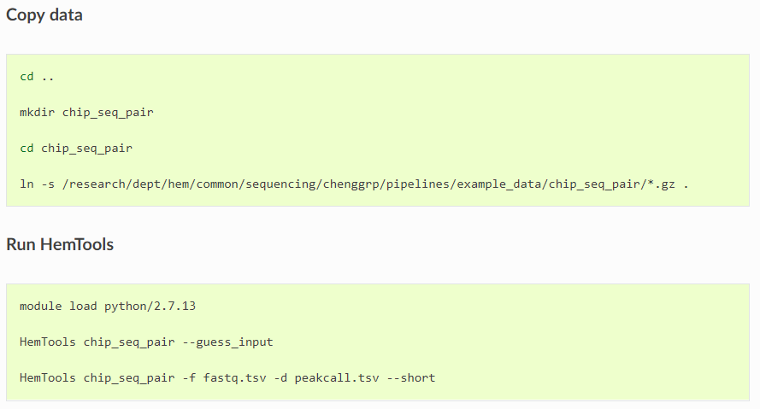
Paired-end ChIP-seq example
https://hemtools.readthedocs.io/en/latest/content/NGS_pipelines/tutorial.html

Slide 13
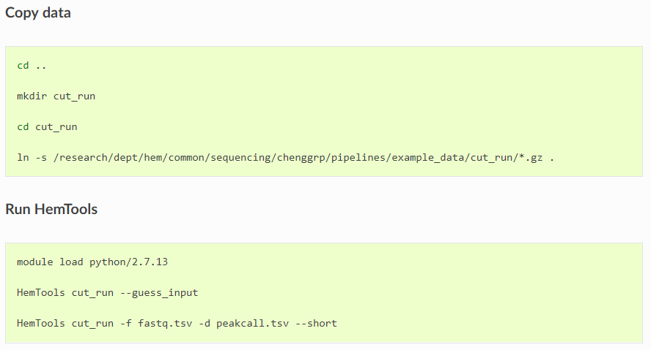
CUT & RUN example
https://hemtools.readthedocs.io/en/latest/content/NGS_pipelines/tutorial.html

Slide 14
General principles
Command format
HemTools subcmd some_required_parameters
HemTools atac_seq -f fastq.tsv
HemTools cut_run -f fastq.tsv -d peakcall.tsv
HemTools chip_seq_single -f fastq.tsv -d peakcall.tsv
HemTools chip_seq_pair -f fastq.tsv -d peakcall.tsv
subcmd is case-insensitive

Slide 15
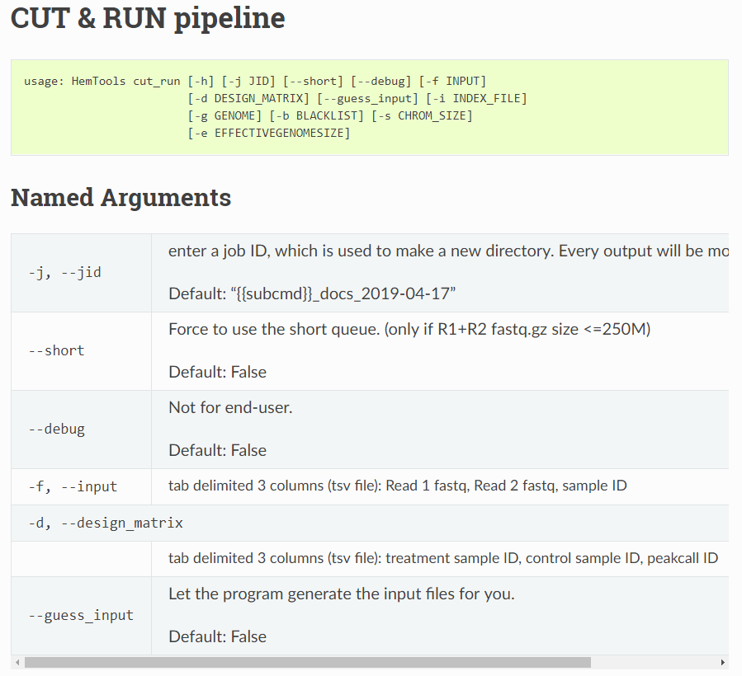
General principles
Required parameters
HemTools atac_seq -f fastq.tsv
HemTools cut_run -f fastq.tsv -d peakcall.tsv
HemTools chip_seq_single -f fastq.tsv -d peakcall.tsv
HemTools chip_seq_pair -f fastq.tsv -d peakcall.tsv

Slide 16
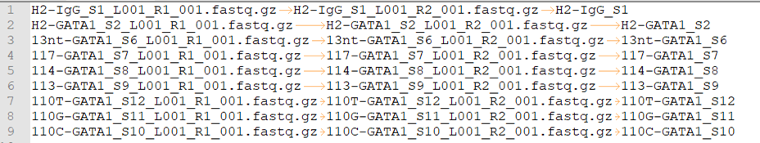
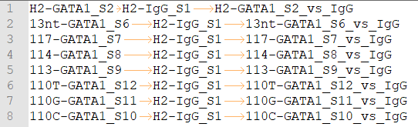
General principles
Command format
HemTools atac_seq -f fastq.tsv
HemTools cut_run -f fastq.tsv -d peakcall.tsv
HemTools chip_seq_single -f fastq.tsv -d peakcall.tsv
HemTools chip_seq_pair -f fastq.tsv -d peakcall.tsv
Input format (tsv, tab-separated values)
-f, --input
-d, --design_matrix

Slide 17
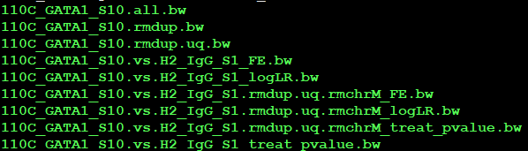
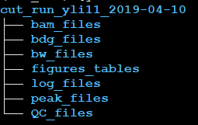
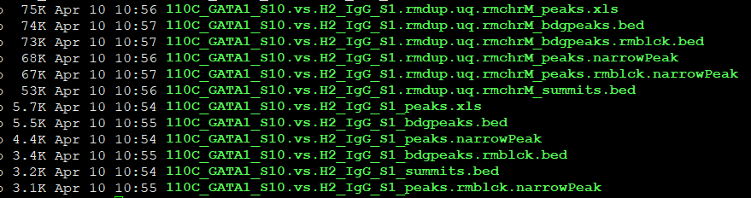
General principles
Output format
Paired-end data will run MACS2 twice:
rmdup.uq bam
raw bam
Single-end data will just run MACS2 using raw bam

Slide 18
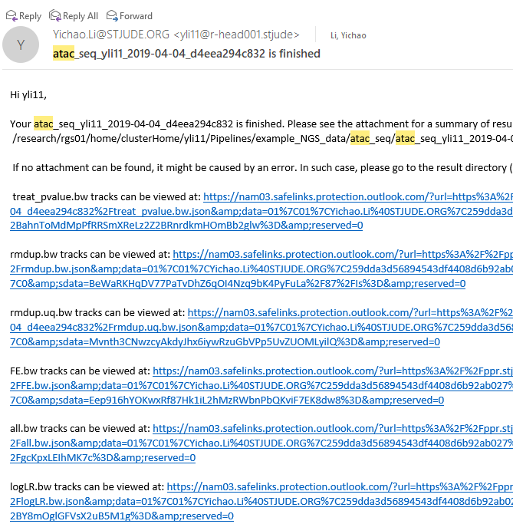
General principles
Report bugs
If no attachment can be found, it might be caused by an error. In such case, please go to the result directory (above) and do HemTools report_bug.
No Attachments!

Slide 19


Questionnaire
https://hemtools.readthedocs.io/en/latest/content/NGS_pipelines/tutorial.html#id4

